Slide 1



Prepared by,
Chetan Shetty Assistant Professor
Department of CSE MSRIT
Bangalore

Slide 2
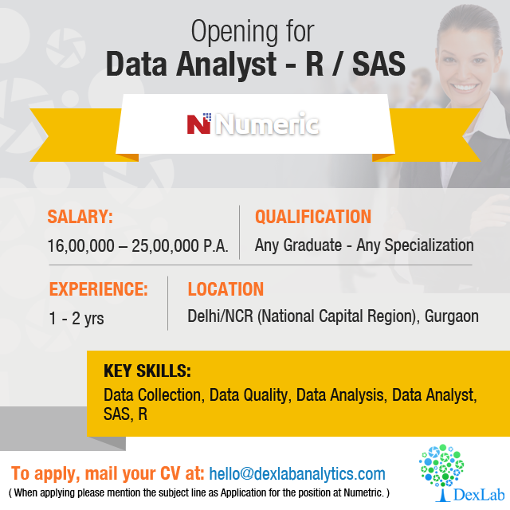

Slide 3


Slide 4


Slide 5
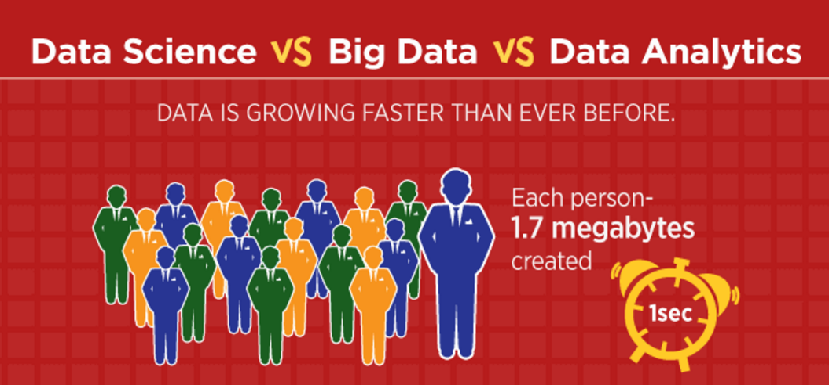

Slide 6
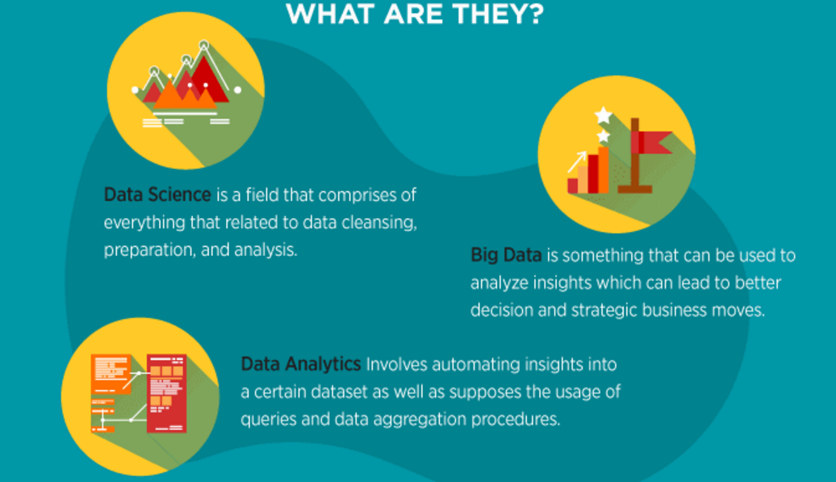

Slide 7
Data Science: Dealing with unstructured and structured data, Data Science is a field that comprises of everything that related to data cleansing, preparation, and analysis.
Big Data: Big Data refers to humongous volumes of data that cannot be processed effectively with the traditional applications that exist.
Data Analytics: Data Analytics the science of examining raw data with the purpose of drawing conclusions about that information.

Slide 8
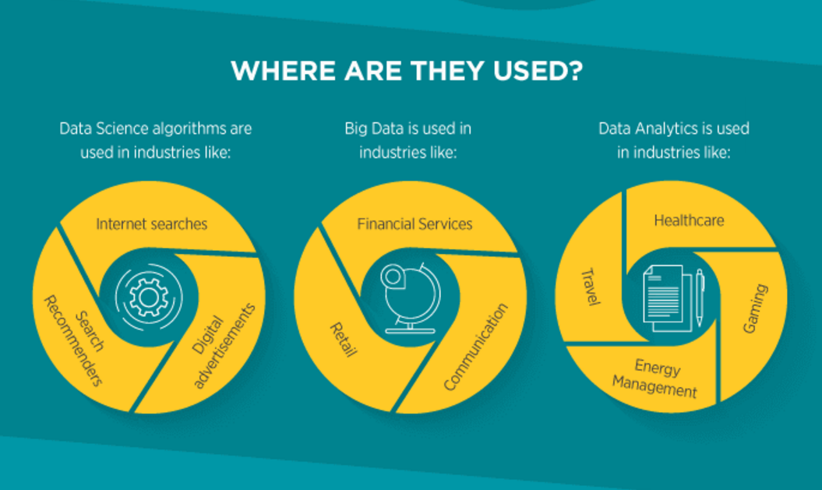

Slide 9
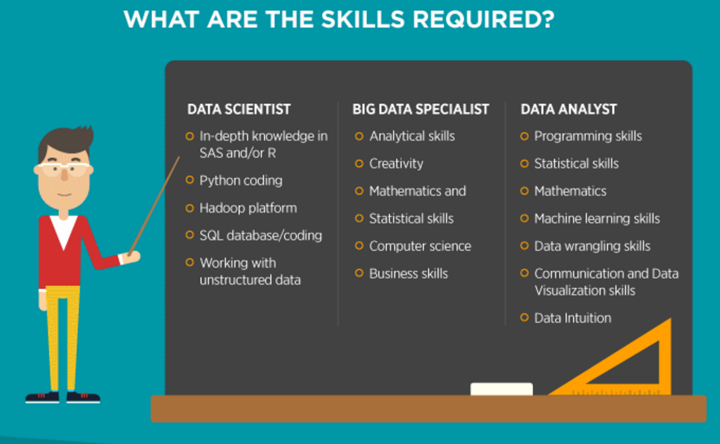

Slide 10
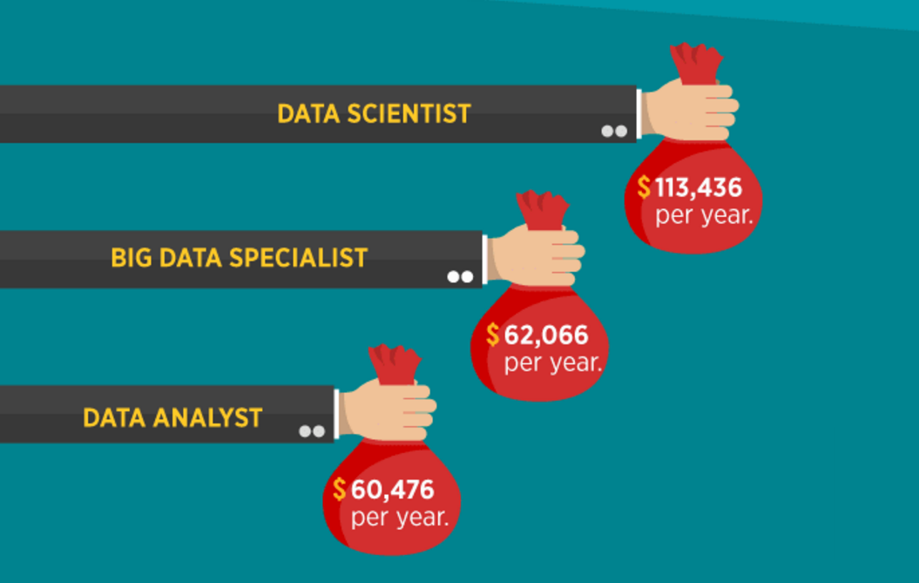

Slide 11
Why Analytics?

Slide 12
Analytics in decision making

Slide 13
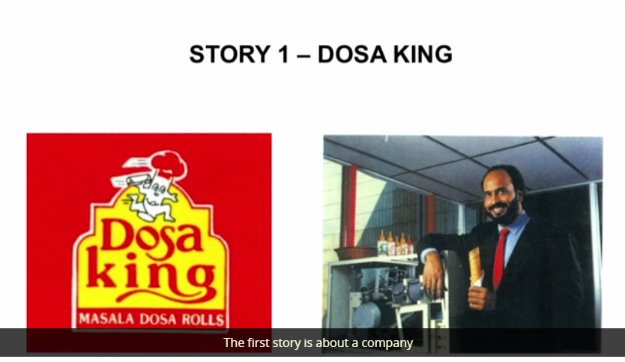

Slide 14
Dosa King was started in 1992 in India.
The idea behind Dosa King is to create a chain of fast food restaurants that would serve dosa.
This was the idea of Narayanan the entrepreneur.
He wanted somebody to fund for this project.
He went to a venture capitalist and asked for few crores so that he can come up with an automatic dosa making machine and start this fast food restaurant chain.
Now the question is whether the venture capitalist should fund this idea. So, how do you know that this idea will become a successful idea?
So this is my first story, we'll come back and compare all three stories after I go through all the stories.

Slide 15
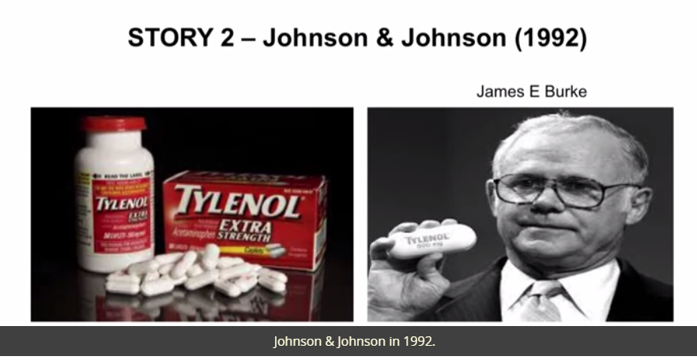

Slide 16
The second story is about Johnson & Johnson in 1992. Couple of people took Tylenol in Chicago and die.
Later it was found that the Tylenol was contaminated with cyanide.
The news reaches Johnson & Johnson headquarters and James Burke was the CEO at that time. So here as an organization they had to take a decision what to do in this case.
One option for them is to withdraw Tylenol from the market but that may lead to competition taking the market owned by Tylenol.
At that time, Tylenol had about more than 60 percent market share. So here they had to take the decision which is very very important and they had to take the decision in quick time.

Slide 17
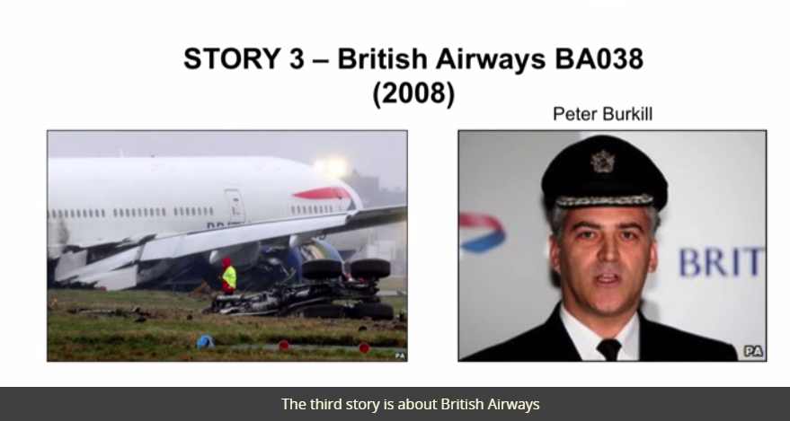

Slide 18
The third story is about British Airways flight BA038.
It was a Boeing 777 flight between Beijing and London, Heathrow.
So it took off from Beijing, it was a smooth flight until they reach London, Heathrow Airport.
As they were about to land, the engine stopped functioning, so there was no power coming and the captain of that particular flight, Peter Burkill, had to crash land, and there was an enquire committee and Peter Burkill was suspended for some time.
Now again if you ask in this situation, what should have been the right decision for Peter Burkill?

Slide 19
Let us compare the three scenarios

Slide 20
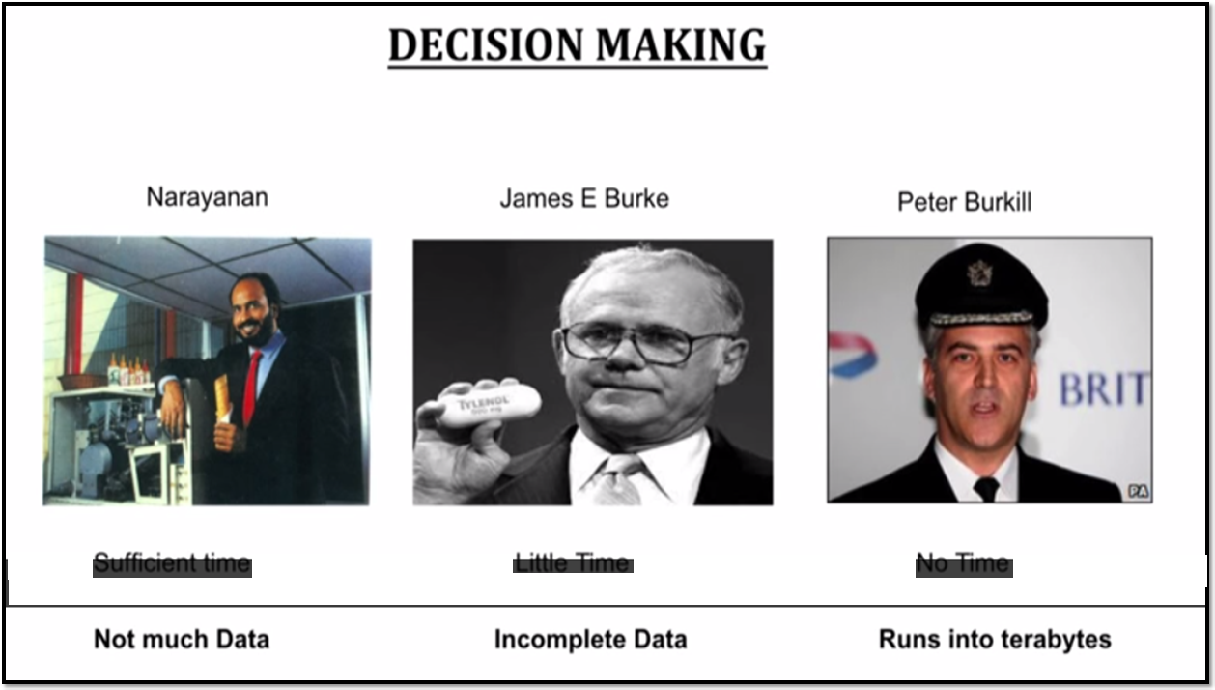

Slide 21
In the first case, where Narayanan was trying to come up with the fast food restaurants, the venture capitalist could have asked Narayanan to come after two or three months. So there was a sufficient time to take decision, but they didn't have much data.
In case of James Burke, the time available for taking decision was very very limited. In fact, they had to take the decision within three or four Hours.
In third case, Peter Burkill had about thirty seconds to take decision.

Slide 22
So what we are seeing is that, there is something called “THEORY OF BOUNDED RATIONALITY” which says the decisions are becoming more complex.
Basically the number of alternatives that are available to the decision maker is huge and the time available to take the decision is very limited.
In such kind of scenarios, one cannot use opinion or gut feeling.
We have to use data to support the decision to ensure that, that’s the right decision.
That's why analytics has become very important, and that’s the reason why many companies today are using analytics to take right decision or solve problems that they are facing internally or with external market.

Slide 23
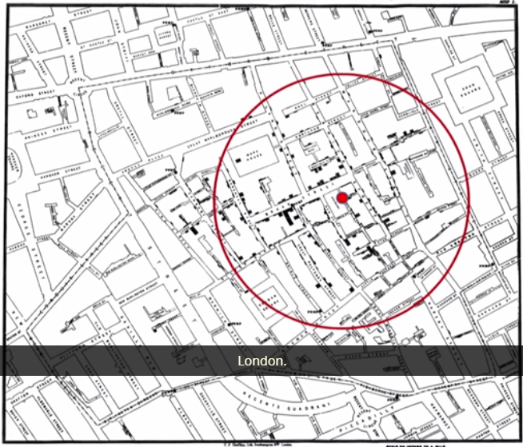
STORY - 1
LONDON CHOLERA 1854

Slide 24
The first story is about London cholera outbreak in 1854. More than 500 people died in this outbreak. And in those days, people thought cholera is an airborne disease.
There was a doctor, whose name was John Snow. So, he prepared a spot map.
He went to different hospitals, and took the addresses of people who died, and prepared a map by putting a tick mark against those addresses.

Slide 25
tick marks are concentrated across or around a street called Broad Street. You don't see many tick marks in other parts of London. So, he thought if it is concentrated in this particular location, there should be something common among these people who are living in that location. That common thing was that they were actually taking water from the same water pump which was situated in Broad Street.

Slide 26
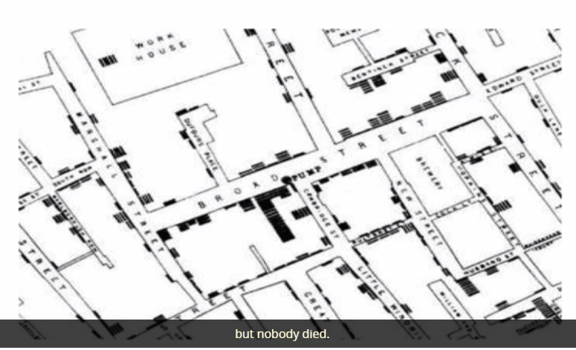
So, he took this map and went to the London municipality and showed them that the cholera is spread through water, so we should stop the pump, which is situated in that broad street. But, the London municipality was not convinced initially because they showed one entire block where there are lot of people living, but nobody died.

Slide 27
John Snow was also surprised with that particular building, so he went there to find the truth. And, when we went there, he realized that it was a brewery, and there were 70 workers working in that brewery. And, most of them were drinking beer, not water. In fact, there was another reason, because they had a separate water pump inside that particular building. So, he found the answer, he went back to the London municipality, and told them why people in that building are not dying.
Finally, London municipality closed down that pump and the death stopped.
See here, we are just looking at a spot map, and using the spot map, John Snow was able to come up with a new hypotheses that the cholera was spread through water, not through air.
Notes:
Brewery → Preparing beer.

Slide 28
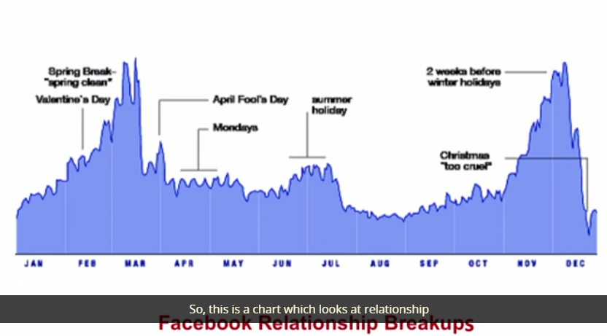
STORY - 2

Slide 29
The example is from Facebook Relationships Breakups. So, this is a chart which looks at relationship breakups, which were announced in Facebook. So, you see two spike; one is happening in December and the other one is in the spring break.
Now, we may try to understand why there is a spike in December and spring break. Now, this is the time the couples get to talk to each other, and probably, they find out that they are living with a wrong person, so they breakup.

Slide 30
So, this is also gives us an insight. What I am trying to convey is that using simple data visualization, we can unearth hidden fact.
If you go back to the London cholera outbreak, till that time people thought that cholera is spread through air. By, just, doing a simple spot map, John Snow was able to come up with a new hypotheses that it is actually spread through water. So, that's the reason why descriptive analytics is very, very important.
A simple data visuals can convey what is hidden in the data.

Slide 31
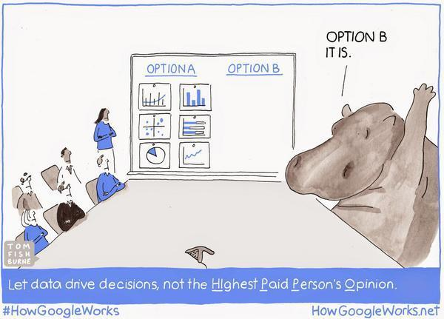
Hippo Algorithm

Slide 32
Business Analytics
And there is one famous approach which is called "Hippo Algorithm" which stands for "Highest Paid Person's Opinion".
What happens is, when organizations face problem they form a committee. And the committee members come with different opinions and typically in most cases they may go with the opinion of the highest paid person or in this case it may be CEO or CFO or some CXO.
When organization take decision based on highest paid persons opinion, they can go wrong.
So support the decision with data, so that's why probably he said in "God we trust, all others must bring data".

Slide 33
Business Analytics is nothing but collection of tools, techniques, processes that can be used for exploration of the past data.
So, after exploration of the past data we can gain insights and those insights can be used for value add or for decision making.
It is an integration between science—science in the form of statistical and mathematical techniques—technology in the form of ERP systems, which are used for collecting the data and business contacts.

Slide 34
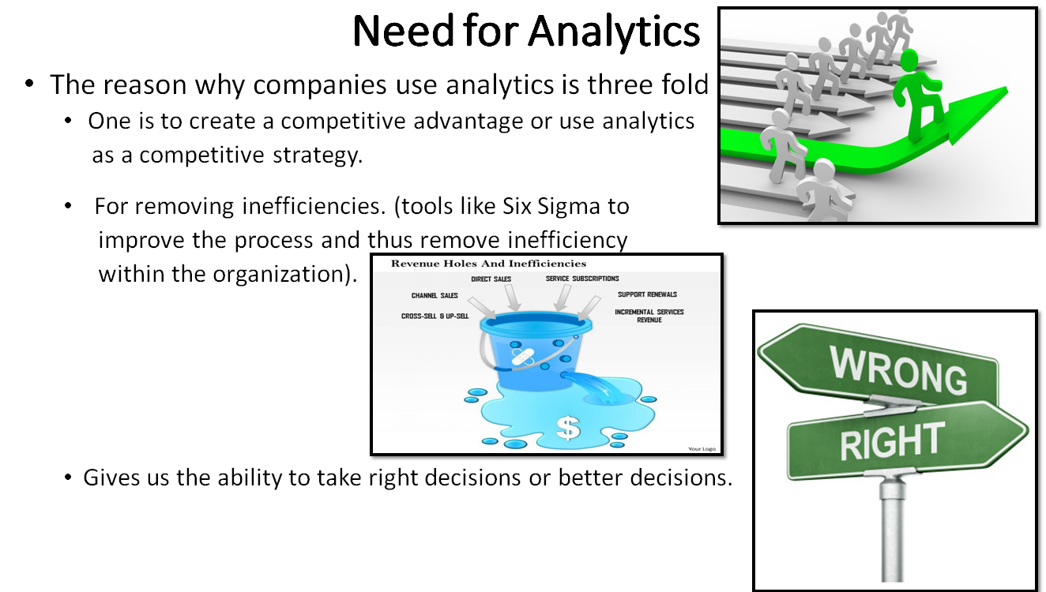

Slide 35
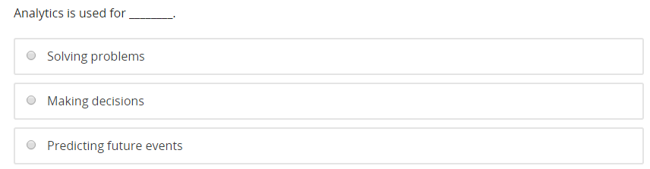
All of the above

Slide 36


Slide 37
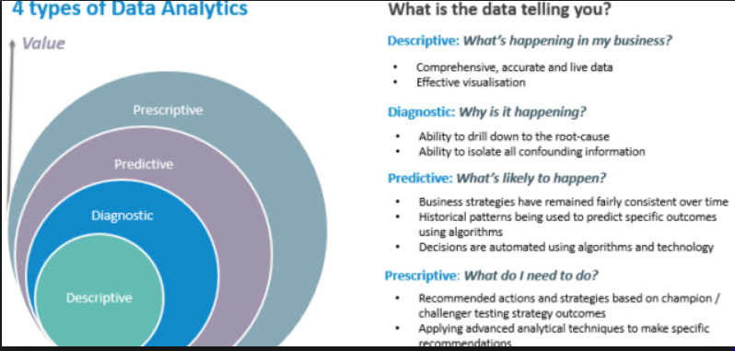
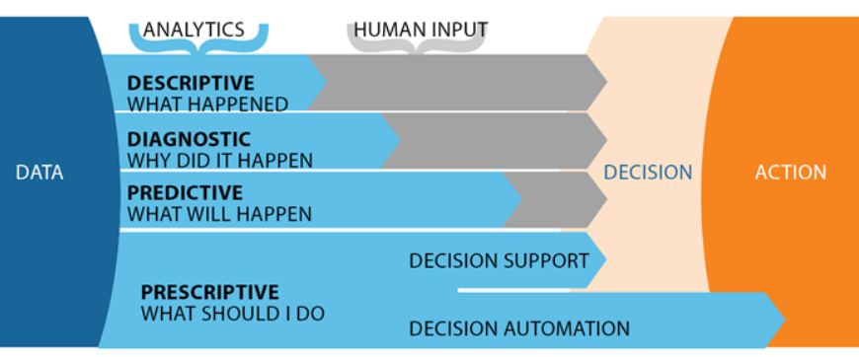

Slide 38
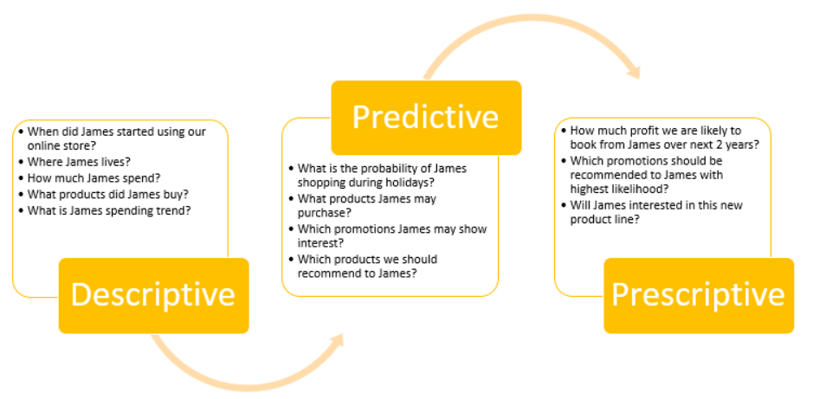

Slide 39
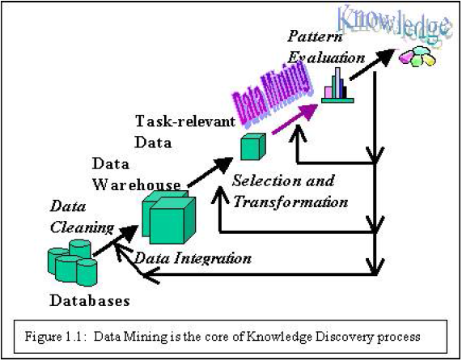
Knowledge Data Discovery

Slide 40
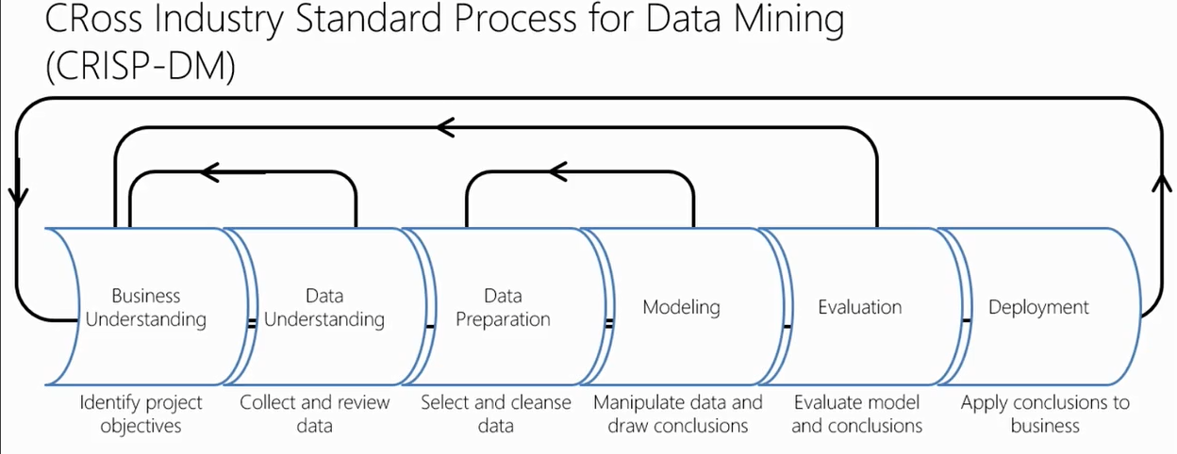

Slide 41
KDD Process
Data cleaning/ cleansing – removal of noisy and irrelevant data
Data integration: multiple data sources, often heterogeneous are combined
Data selection: the data relevant to the analysis is decided on and retrieved
Data transformation/consolidation: selected data is transformed into forms appropriate for the mining procedure.
Data mining: clever techniques are applied to extract useful patterns
Pattern evaluation: strictly interesting patterns representing knowledge are identified based on given measures.
Knowledge representation: Discovered knowledge is visually represented to the user.

Slide 42
Types of data
There are 2 types of data:
Quantitative or numeric
Qualitative or categorical
Quantitative data:
Is information about quantities; that is, information that can be measured and written down with numbers.
Example:
Your height, Your shoe size, length of your fingernails.
Qualitative data or categorical data(ordinal or nominal):
Is information about qualities; information that can't actually be measured.
Example:
Softness of your skin, The grace with which you run, The color of your eyes.
Comparing 2 states

Slide 43
categorical data(ordinal or nominal):
When there is no a natural ordering of the categories, we call these nominal categories.
Examples might be gender, race, religion, or sport.
When the categories may be ordered, these are called ordinal variables.
Categorical variables that judge size (small, medium, large, etc.) are ordinal variables.
Attitudes (strongly disagree, disagree, neutral, agree, strongly agree) are also ordinal variables

Slide 44
The age of your car.
(Quantitative.)
The number of hairs on your knuckle.
(Quantitative.)
The softness of a cat.
(Qualitative.)
The color of the sky.
(Qualitative.)
The number of pennies in your pocket.
(Quantitative.)

Slide 45
One other type of data you'll need to know is categorical data. This is data that can be organized into mutually exclusive categories. If we look at a bunch of bananas and they're all either green, brown, yellow, or blue, then we could use the categories "green," "brown," "yellow," and "blue" to record our data.
Four students had brown hair, six had blonde hair, and three had red hair.
This statement refers to categorical data.

Slide 46
Discrete and Continuous Variable
Data is discrete if there's clear separation between the different possible values.
If we flip a coin and record the result there are only two possible values H and T. There's no possible value between H and T, so our observations are discrete.
Data is continuous if there's no clear separation between possible values.
If we measure someone's height in centimeters we could get 160 cm, or 160.01 cm, or 160.001 cm.
For any two possible values (say, 160 cm and 161 cm), there's another possible value between them (160.5 cm).

Slide 47
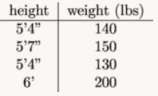
UNIVARIATE Vs BIVARIATE DATA
Single-variable or univariate data refers to data where we're only observing one aspect of something at a time.
We take a group of people, measure their heights, and get this list of heights:
5'2'', 5'4'', 6'1'', 5'9'', 5'3''.
With two-variable, or bivariate data, we observe two aspects. We can put our observations into a table.
We take a group of people, measure their heights and weights, and get the following information:

Slide 48
WHY DO WE NEED TO CLEAN THE DATA?
Raw is unpreprocessed, incomplete, and noisy.
For example, the databases may contain
Fields that are obsolete or redundant
Missing values
Outliers
Data in a form not suitable for the data mining models
Data cleaning and data transformation accounts for 10-60% of efforts in data mining process

Slide 49
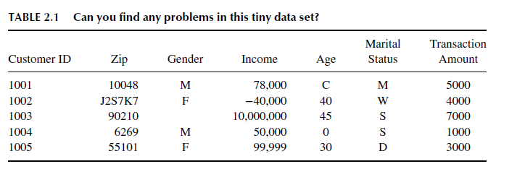
DATA CLEANING

Slide 50
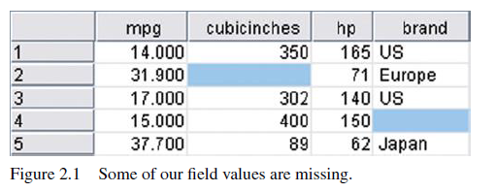
HANDLING MISSING DATA (1)
cars data set, consists of information about 261 automobiles manufactured in the 1970s and 1980s, including gas mileage, number of cylinders, cubic inches, horsepower, and so on.

Slide 51
HANDLING MISSING DATA (2)
omit the records or fields with missing values from the analysis - lead to a biased subset of the data, specially when only one field value is missing.
Generally 80% of records have at least one missing value
Better solution is to replace missing values

Slide 52
HANDLING MISSING DATA (2)
Replace the missing value with:
Some constant, specified by the analyst.
With the field mean (for numeric variables) or the mode (for categorical variables).
A value generated at random from the observed distribution of the variable.

Slide 53
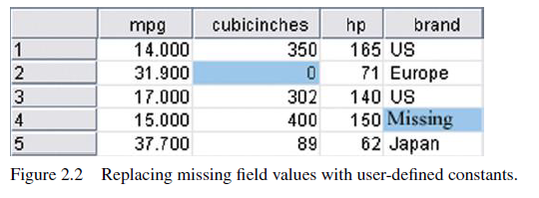
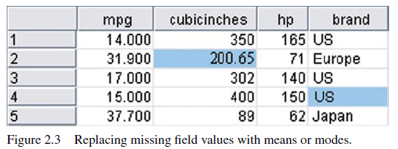
HANDLING MISSING DATA (3)

Slide 54
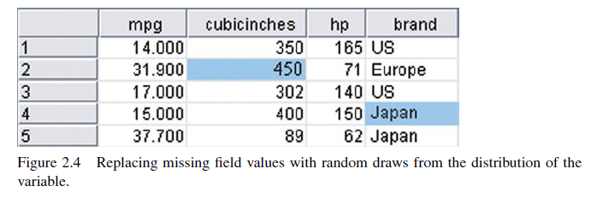
HANDLING MISSING DATA (4)

Slide 55
HANDLING MISSING DATA (5)
Mean may not always be the best if many missing values are replaced with the mean, the resulting confidence levels for statistical inference will be overoptimistic
Replacing with random values - there is no guarantee that the resulting records would make sense.
In data imputation(Process of replacing missing data), we ask “What would be the most likely value for this missing value, given all the other attributes for a particular record?”

Slide 56
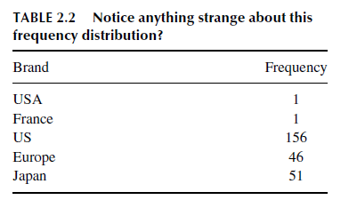
IDENTIFYING MISCLASSIFICATIONS (1)

Slide 57
IDENTIFYING MISCLASSIFICATIONS (2)
The frequency distribution shows five classes, USA, France, US, Europe, and Japan.
However, two of the classes, USA and France, have a count of only one automobile each and have been inconsistently classified with respect to the origin of manufacture.
To maintain consistency with the remainder of the data set, the record with origin USA should have been labelled US, and the record with origin France should have been labelled Europe

Slide 58
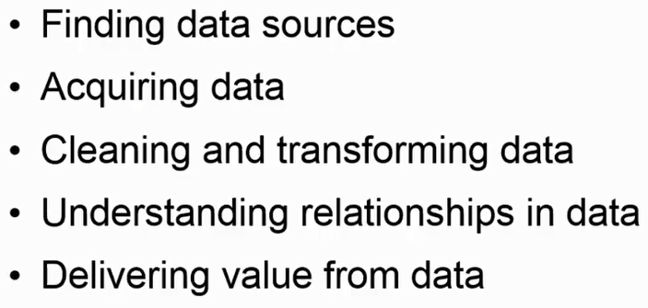

Slide 59
What kind of Data can be mined?
Algorithms and approaches may differ when applied to different types of data
The following data can be mined
Flat files: Flat files are simple data files in text or binary format.
Relational Databases: A relational database consists of a set of tables containing either values of entity attributes where columns represent attributes and rows represent tuples.

Slide 60
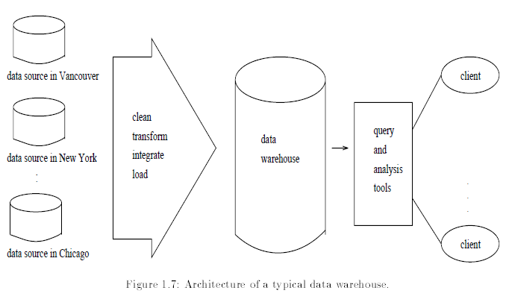
Data warehouses: where columns represent attributes and rows represent tuples. A data warehouse gives the option to analyze data from different sources under the same roof.

Slide 61
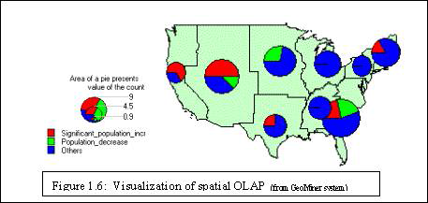
Transaction Databases: A transaction database is a set of records representing transactions, each with a time stamp, an identifier and a set of items.
For example, in the case of the video store, the rentals table represents the transaction database.
Multimedia Databases: Multimedia databases include video, images, audio and text media.
Spatial Databases: In addition to usual data, stores geographical information like maps, and global or regional positioning.

Slide 62
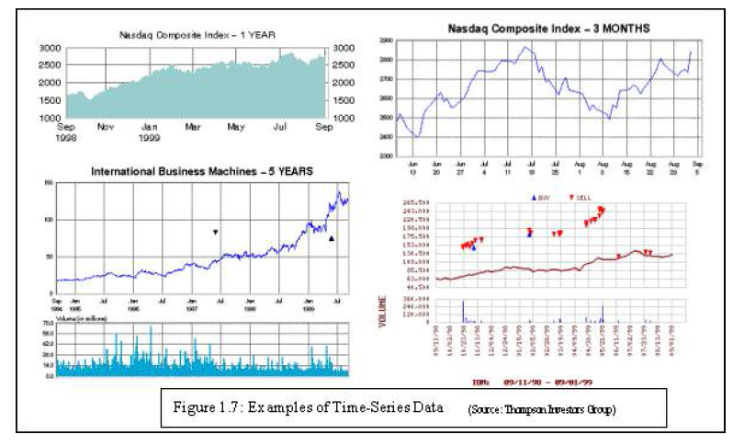
Time Series Databases: Contains time related data such as stock market data or logged activities.
Usually have a continuous flow of new data coming in, that requires real time analysis.
World wide web:
Conceptually, the World Wide Web is comprised of three major components:
The content of the Web, which encompasses documents available
The structure of the Web, which covers the hyperlinks and the relationships between documents
the usage of the web, describing how and when the resources are accessed.

Slide 63


Slide 65
What R does and does not
data handling and storage: numeric, textual
matrix algebra
hash tables and regular expressions
high-level data analytic and statistical functions
classes (“OO”)
graphics
programming language: loops, branching, subroutines
is not a database, but connects to DBMSs
language interpreter can be very slow, but allows to call own C/C++ code
no spreadsheet view of data, but connects to Excel/MsOffice
no professional / commercial support

Slide 66
APPLICATION AREAS
Bioinformatics | Operations Research
Statistics | Artificial Intelligence
Linear Algebra | Machine learning
Data Mining | Data visualization
Analysis of Big Data | Making predictions

Slide 67
R is an open source system widely used in statistics, bioinformatics, finance field etc.
It's data structure and working environment are perfect for analysis of large sized data.
Many classical and modern statistical algorithms are implemented.
The R Project home page is http://www.r-project.org
R packages address is (http://CRAN.R-project.org).
Books about R are freely available at http://cran.r-project.org/doc/contrib/

Slide 68
R Installation on Ubuntu
Step 1: Install R
sudo apt-get update
sudo apt-get install r-base
Type $R (In capital)
Step 2: Install R studio
Go to R-studio.com
Click on R-studio Desktop
Click on R-Studio Desktop
Select Ubuntu version with 32/64 bit
Click on the downloaded software and click on install
Click on search and select R- Studio

Slide 69
R editors (recommended)
• Notepad++: Windows Only
• gedit: Redhat Linux Only
• RStudio: Powerful IDE, works on Windows, Mac and Linux

Slide 70
URL :Download R
https://cran.r-project.org/bin/windows/base/
URL :Download R Studio
https://www.rstudio.com/products/rstudio/download2/

Slide 71
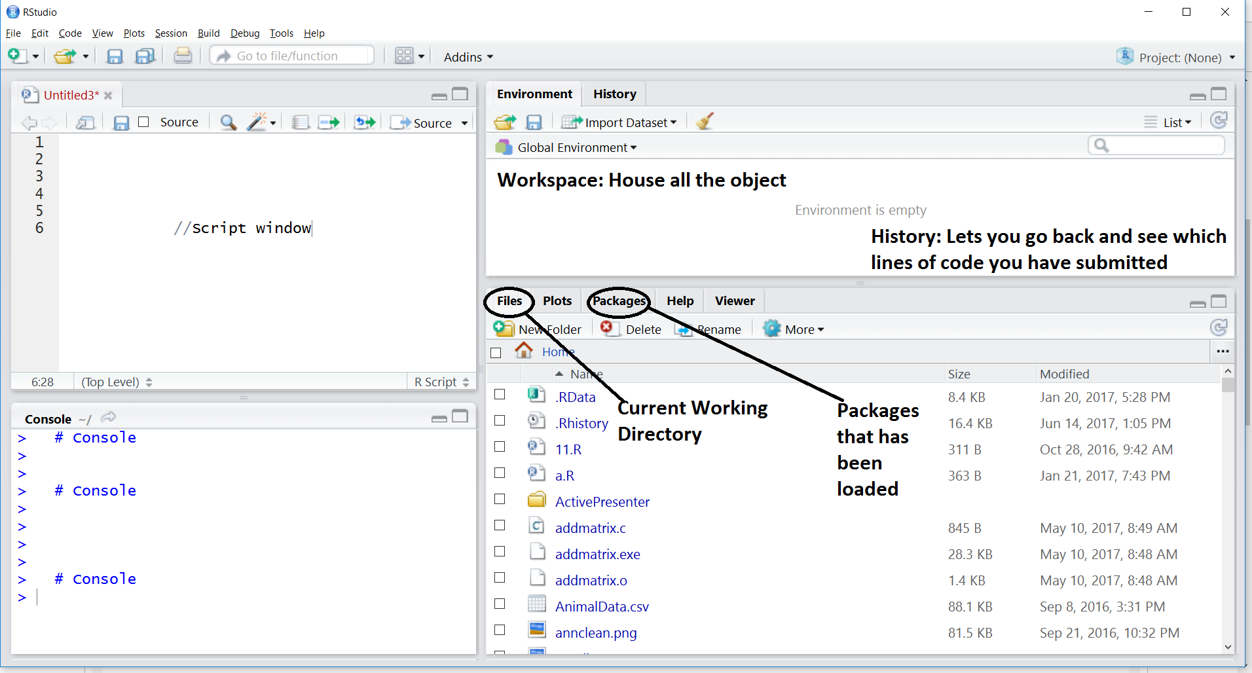

Slide 72
Quit R:
>q()
If you select "save Workspace image" during quit, all R objects will be written into a file ".RData" in the working directory.
All history command will be recorded into a file ".RHistory" in the working directory.
By default, R will load all objects while starting. This may save time if you want to read a large file, but waste you time if you do not need the objects. You can delete the .RData and .Rhistory under the R working directory.
Getting Help, for example function plot(): >?plot
>help(plot)
>??plot
Execute a R command file: >source("test.R")

Slide 73
Commands
>sink("output.txt") #Divert output from console to file
>sink() #Restores to the console output
>objects() #Display current objects
>ls() #Display current objects
>rm(x) #Remove object x from R work space
>getwd() #Display current work directory
>setwd() #Set current work directory
>data() #Display all built in datasets
>install.packages("mmass") #Install package mmass
>installed.packages() #Display all installed packages
>ls("package:base") #List all functions of R Base

Slide 74
R - PACKAGES
How many packages exist on CRAN?
The answer is 6,789 (on June 18th, 2015).
10,000 (2017)

Slide 75
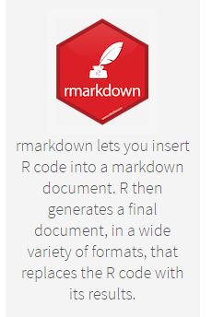


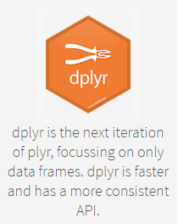
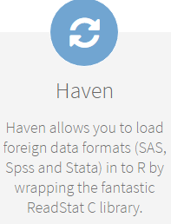


Slide 76



Slide 77
R As A Calculator
> log2(32)
[1] 5
> sqrt(2)
[1] 1.414214
> seq(0, 5, length=6)
[1] 0 1 2 3 4 5
> plot(sin(seq(0, 2*pi, length=100)))

Slide 78
Object orientation
primitive (or: atomic) data types in R are:
numeric (integer, double, complex)
character
logical
function
out of these, vectors, arrays, lists can be built.

Slide 79
1. Variables
Store a variable to reuse later
<-
Example:
height <- 2
width <- 4
Area <- height * width
2. Workspace
It is a place where variables and information is store in R
Can access the objects in the workspace with ls( ) function
ls( )

Slide 80
Variables
> a = 49
> sqrt(a)
[1] 7
> a = "The dog ate my homework"
> sub("dog","cat",a)
[1] "The cat ate my homework“
> a = (1+1==3)
> a
[1] FALSE
3. Comments
# create variables height and width
numeric
character string
logical

Slide 81
4. Cleaning workspace
If you are working on big projects that have tons of data involved, this workspace consumes lot of computer resources. Its good idea to clean up your workspace from time to time to make sure it does not get bloated.
Command: rm( )
rm(area)

Slide 82
DATA TYPES
class() → To reveal type
Ex: TRUE
class(TRUE) → “logical”
1. Logical → TRUE/T , FALSE/F , NA
2. Numeric → 2, 2.5…
Integer(Type of numeric) → 2L (L→ Long)
Class(2)
Class(2L)

Slide 83
3. To see if a variable is numeric:
is. Numeric(2)
is.numeric(2L)
To check if number is integer:
is.integer(2)
is.integer(2L)
4. Character
“I love data science”
class(“I love data science”)

Slide 84
5. COMPLEX
A complex value in R is defined via the pure imaginary value I
z = 1 + 2i # create a complex number
class(z) # print the class name of z
6. RAW
name<-”HELLO”
charToRaw(name)
rawToChar(name)
rawToBits(name)
"Hello" is stored as 48 65 6c 6c 6f
7. Double
double(3)

Slide 85
5. Coercion: To change the type of one variable to another variable.
as.numeric(TRUE)
as.character(4)
as.numeric(“4.5”)
as.integer(“4.5”)
as.numeric(“Hello”) → NA(Not Available)

Slide 86
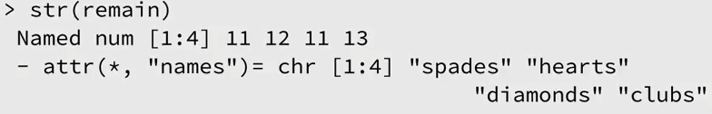
str( ) → shows the structure of the vector
> str(remain)
Single value = vector
> my_apples ← 5
> my_oranges ← “six”
> is.vector(my_apples)

Slide 87
CREATE AND NAME VECTOR

Slide 88
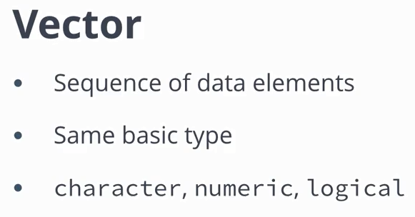

Slide 89
#Create a vector
> c( )
#Create a vector
> c(“hearts”, “spades”, “diamonds”, “diamonds”, “spades”)
#Create a vector and assign it to “drawn_suits”
> drawn_suits ← c(“hearts”, “spades”, “diamonds”, “diamonds”, “spades”)
#Print drawn_suits
> drawn_suits
#Check the type of “drawn_suits”
> is.vector(drawn_suits)
> remain ← c(11,12,11, 13)

Slide 90
> suits ← c(“hearts”, “spades”, “diamonds”, “diamonds”, “spades”)
> remain ← c(11,12,11, 13,14)
#Name a vector: Use names function
> names(remain) ← suits [Method – 1]
#print remain
> remain
> remain ← c(hearts=11,spades=12,diamonds=11, clubs=13) [Method – 2]
> remain ← c(“hearts”=11, “spades”=12, “diamonds”=11, “clubs”=13) [Method – 3]

Slide 91
str( ) → shows the structure of the vector
> str(remain)
Single value = vector
> my_apples ← 5
> my_oranges ← “six”
> is.vector(my_apples)

Slide 92
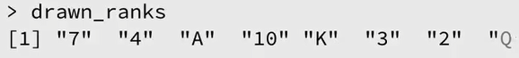
length( )
> length(drawn_suits)
VECTORS ARE HOMOGENEOUS
Only elements of same type.
Automatic coercion if necessary.
COERCION FOR VECTORS
> drawn_ranks ← c( 7, 4, ”A”, 10, ”K”, 3, 2 ,”Q” )
>class(drawn_ranks)

Slide 93
VECTOR ARITHMETIC

Slide 94
> earnings ← c(50,100,30)
> earnings * 3
> earnings /10
> earnings -20
> earnings +100
> earnings ^2

Slide 95
> earnings ← c(50, 100, 30)
> expenses ← c(30, 40, 80)
> earnings - expenses
> earnings + c( 10, 20, 30)
> earnings * c( 10, 20, 30)
> earnings / c( 10, 20, 30)

Slide 96
> earnings ← c(50, 100, 30)
> expenses ← c(30, 40, 80)
>bank <- earnings – expenses
>bank
sum() function
> sum(bank)
Comparison operator
> earnings > expenses
(Result Is logical )

